Slide 1


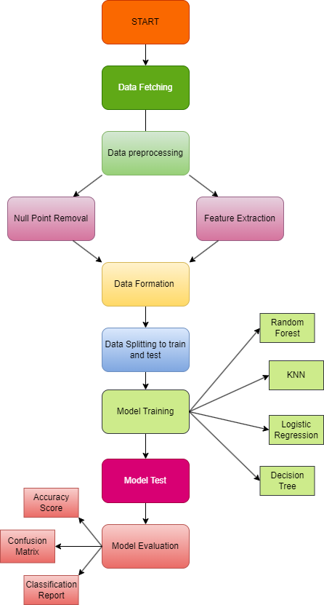

SYMBIOSIS INSTITUTE OF TECHNOLOGY (SIT)
DEPARTMENT OF ROBOTICS AND AUTOMATION
TITLE: Web Phishing Detection using Machine Learning Algorithms
Name of Students: Ansh Sharma, Priyanshu Lathi
INTRODUCTION:
Web phishing poses a significant threat to online security. Leveraging machine learning algorithms enhances our ability to detect and mitigate phishing attacks effectively. This poster explores the application of machine learning techniques in the detection of web phishing incidents.
OBJECTIVES & AIMS:
The objective of this study is to develop a machine learning-based system for detecting web phishing attempts. Our aims include identifying key features indicative of phishing websites, evaluating the performance of various machine learning algorithms, and ultimately providing a reliable solution to enhance online security for users by accurately identifying and mitigating phishing threats.
METHODOLOGY
Dataset Description:
The dataset comprises 11,430 instances with 89 features, including URL attributes like length and presence of certain characters, and webpage characteristics such as hyperlinks and domain age. Features like 'ip' and 'phish_hints' help discern potential phishing attempts.
Data Preprocessing:
Null Point Removal
Feature Extraction
Model Training & Testing:
Data Splitting
Model Training
Parameter Tuning
Diagrams
RESULTS:
Performance Metrics:
Random Forest: 95% accuracy
K-Nearest Neighbors (KNN): 94% accuracy
Logistic Regression: 92% accuracy
Decision Tree: 95% accuracy
CONCLUSIONS:
In conclusion, this research highlights machine learning's effectiveness in detecting web phishing using a diverse dataset. Models like K-Nearest Neighbors, Logistic Regression, and Random Forest achieved high accuracy, emphasizing the importance of feature selection and data quality. Future advancements and real-time monitoring can bolster cybersecurity against evolving threats
ACKNOWLEDGEMENT: Dr. Sachit T.S

